Slide 1
ATAI
Advanced Techniqueof Artificial Intelligence
ATAI
ChongqingUniversity _{AdvancedTechniqueof}
of Technology Artificial Intelligence
Chongqing University of
Technology
Chongqing University ^{ATAI}
_{of Technology} Advanced Techniqueof
Artificial Intelligence
Chongqing University of Technology
Chongqing University of Technology
MONET: Modality-Embracing Graph Convolutional Network and
Target-Aware Attention for Multimedia Recommendation
CODE :https://github.com/Kimyungi/MONET.
—— WSDM 2024
Reported by ZhenDong Huang
1

Slide 2
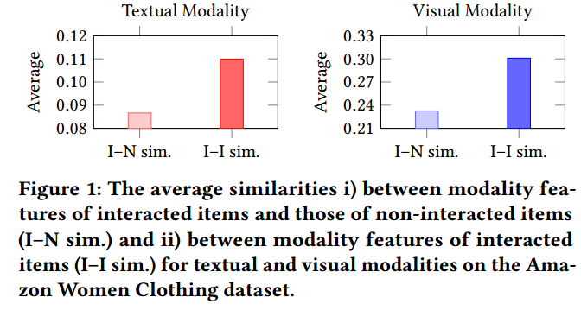
ATAI
AdvancedTechniqueof
Artificial Intelligence
ATAI
ChongqingUniversity _{AdvancedTechniqueof}
of Technology Artificial Intelligence
ChongqingUniversity of Technology
Motivation

Slide 3
ATAI
AdvancedTechniqueof
Artificial Intelligence
ATAI
ChongqingUniversity _{AdvancedTechniqueof}
of Technology Artificial Intelligence
ChongqingUniversity of Technology
Motivation
(1) they cannot sufficiently reflect the multimodal features in the final user/item embeddings.
(2). Existing GCN-based multimedia recommender systems represent a user as a single embedding in which her interests for all interacted items are equally reflected

Slide 4
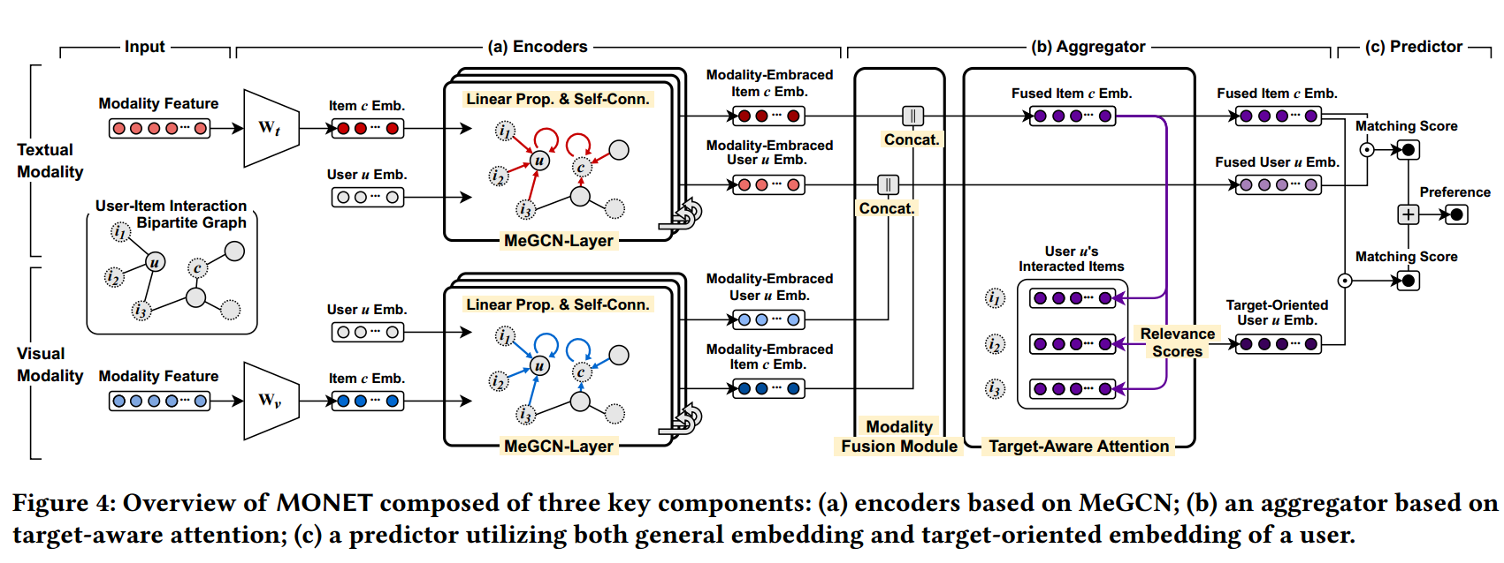
ChongqingUniversity of Technology
ATAI
AdvancedTechniqueof
Artificial Intelligence
ATAI
ChongqingUniversity _{AdvancedTechniqueof}
of Technology Artificial Intelligence
Overview

Slide 5
ChongqingUniversity of Technology
ATAI
AdvancedTechniqueof
Artificial Intelligence
ATAI
ChongqingUniversity _{AdvancedTechniqueof}
of Technology Artificial Intelligence
Method

Slide 6
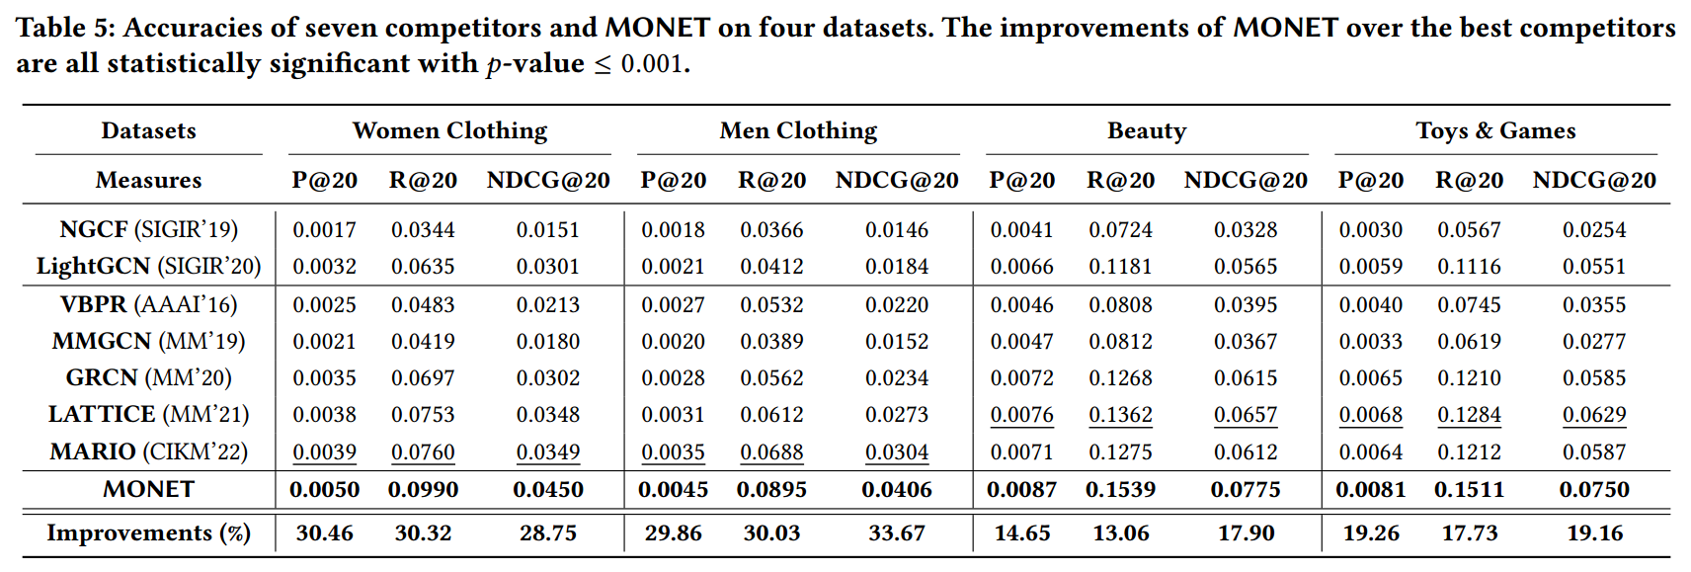
ATAI
AdvancedTechniqueof
Artificial Intelligence
ATAI
ChongqingUniversity _{AdvancedTechniqueof}
of Technology Artificial Intelligence
ChongqingUniversity of Technology
Experiments

Slide 7
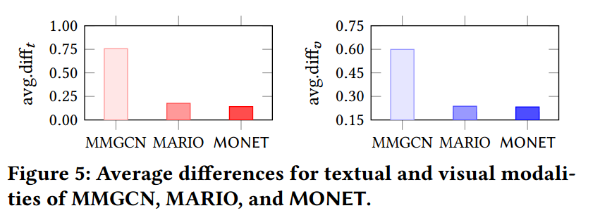
ATAI
AdvancedTechniqueof
Artificial Intelligence
ATAI
ChongqingUniversity _{AdvancedTechniqueof}
of Technology Artificial Intelligence
ChongqingUniversity of Technology
Experiments

Slide 8
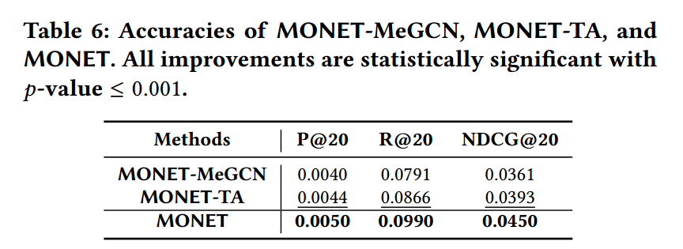
ATAI
AdvancedTechniqueof
Artificial Intelligence
ATAI
ChongqingUniversity _{AdvancedTechniqueof}
of Technology Artificial Intelligence
ChongqingUniversity of Technology
Experiments

Slide 9
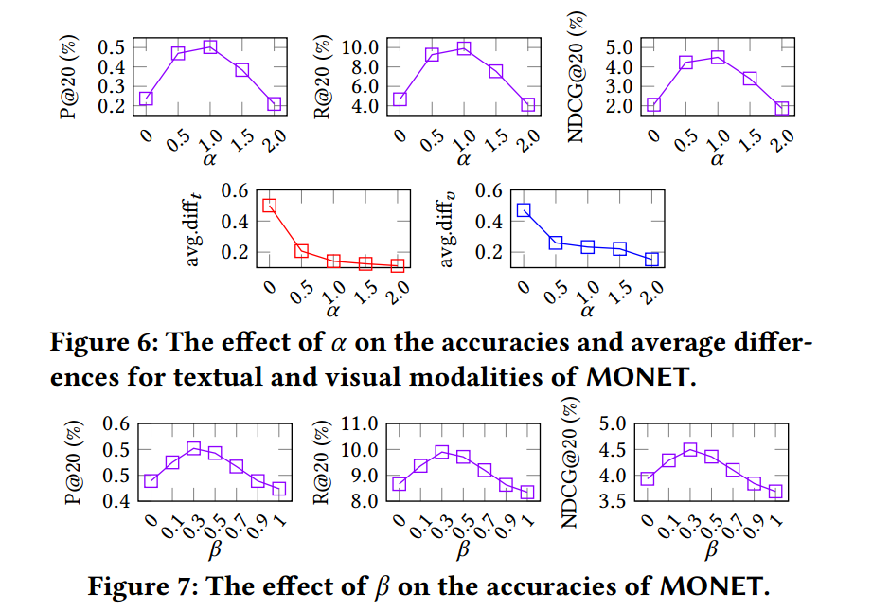
ChongqingUniversity of Technology
ATAI
AdvancedTechniqueof
Artificial Intelligence
ATAI
ChongqingUniversity _{AdvancedTechniqueof}
of Technology Artificial Intelligence
Experiments

Slide 10
ChongqingUniversity of Technology
ATAI
AdvancedTechniqueof
Artificial Intelligence
ATAI
ChongqingUniversity _{AdvancedTechniqueof}
of Technology Artificial Intelligence
Thanks!

